Slide 1

Principles of Economics
Swagat Kishore Mishra
Lecturer, Dept. of Economics
Email: swagat@bits-goa.ac.in / sayswagat@gmail.com
VOIP: 207 PSRN: 485 CHAMBER: A-301/16
Tel. 0832-2580207 (O) 08879506995 (M)

Slide 2
Contents
Market forms
Oligopoly
Monopolistic Competition
Practice Set

Slide 3
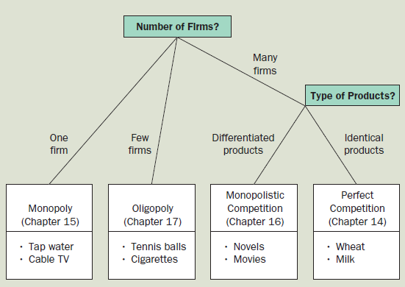

Markets

Slide 4
Oligopoly
A market structure in which only a few sellers offer similar or identical products.
To understand the behavior of oligopolies, let’s consider an oligopoly with only two members, called a duopoly.
The analysis of oligopoly offers an opportunity to introduce game theory, the study of how people behave in strategic situations.

Slide 5
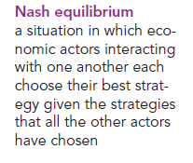
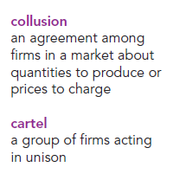
Game theory
The study of how people behave in strategic situations.
(It is named after economic theorist John Nash, whose life was portrayed in the book and movie A Beautiful Mind.)

Slide 6
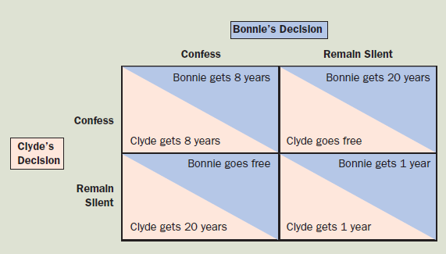
The Prisoners’ Dilemma In this game between two criminals suspected of committing a crime, the sentence that each receives depends both on his or her decision whether to confess or remain silent and on the decision made by the other.

Slide 7
Oligopoly models
Cournot model (Nash equilibrium)
Kinked demand curve model
Cartel

Slide 8
Oligopoly
The Cournot Model
Oligopoly model in which firms produce a homogeneous good, each firm treats the output of its competitors as fixed, and all firms decide simultaneously how much to produce
Firm will adjust its output based on what it thinks the other firm will produce
Notes:
32

Slide 9
Firm 1’s Output Decision
P₁
Firm 1 and market demand curve, D₁(0), if Firm 2 produces nothing.
D₁(0)
If Firm 1 thinks Firm 2 will produce
50 units, its demand curve is
shifted to the left by this amount.
If Firm 1 thinks Firm 2 will produce
75 units, its demand curve is
shifted to the left by this amount.
MR₁(0)
D₁(75)
MR₁(75)
MC₁
MR₁(50)
D₁(50)
12.5
25
50
Q₁
Notes:
38

Slide 10
Oligopoly
The Reaction Curve
The relationship between a firm’s profit-maximizing output and the amount it thinks its competitor will produce
A firm’s profit-maximizing output is a decreasing schedule of the expected output of Firm 2
Notes:
39

Slide 11
Reaction Curves and Cournot Equilibrium
Q₁
Firm 1’s reaction curve shows how much it
will produce as a function of how much
it thinks Firm 2 will produce. The x’s
correspond to the previous model.
100
75
Firm 2’s Reaction
Curve Q*₂(Q₁)
50
x
Firm 2’s reaction curve shows how much it
will produce as a function of how much
it thinks Firm 1 will produce.
x
25
Firm 1’s Reaction
Curve Q*₁(Q₂)
x
x
Q₂
25
50
75
100
Notes:
43

Slide 12
Reaction Curves and Cournot Equilibrium
Q₁
100
In Cournot equilibrium, each
firm correctly assumes how
much its competitors will
produce and thereby
maximizes its own profits.
75
Firm 2’s Reaction
Curve Q*₂(Q₁)
50
x
Cournot
Equilibrium
x
25
Firm 1’s Reaction
Curve Q*₁(Q₂)
x
x
Q₂
25
50
75
100
Notes:
43

Slide 13
Cournot Equilibrium
Each firm’s reaction curve tells it how much to produce given the output of its competitor
Equilibrium in the Cournot model, in which each firm correctly assumes how much its competitor will produce and sets its own production level accordingly

Slide 14
The Linear Demand Curve
An Example of the Cournot Equilibrium
Two firms face linear market demand curve
We can compare competitive equilibrium and the equilibrium resulting from collusion
Market demand is P = 30 - Q
Q is total production of both firms:
Q = Q₁ + Q₂
Both firms have MC₁ = MC₂ = 0
Notes:
45
4

Slide 15
Oligopoly Example
Firm 1’s Reaction Curve → MR = MC
Notes:
46
4

Slide 16
Oligopoly Example
An Example of the Cournot Equilibrium
Notes:
47
4

Slide 17
Oligopoly Example
An Example of the Cournot Equilibrium
Notes:
48
4

Slide 18
Duopoly Example
Q₁
30
The demand curve is P = 30 - Q and
both firms have 0 marginal cost.
Firm 2’s
Reaction Curve
Cournot Equilibrium
15
10
Firm 1’s
Reaction Curve
10
15
30
Q₂
Notes:
54

Slide 19
Observations of Oligopoly Behavior
In some oligopoly markets, pricing behavior in time can create a predictable pricing environment and implied collusion may occur
In other oligopoly markets, the firms are very aggressive and collusion is not possible
Notes:
99

Slide 20
Observations of Oligopoly Behavior
In other oligopoly markets, the firms are very aggressive and collusion is not possible
Firms are reluctant to change price because of the likely response of their competitors
In this case, prices tend to be relatively rigid
Notes:
100

Slide 21
Price Rigidity
Firms have strong desire for stability
Price rigidity – characteristic of oligopolistic markets by which firms are reluctant to change prices even if costs or demands change
Fear lower prices will send wrong message to competitors, leading to price war
Higher prices may cause competitors to raise theirs

Slide 22
Price Rigidity
Basis of kinked demand curve model of oligopoly
Each firm faces a demand curve kinked at the current prevailing price, P*
Above P*, demand is very elastic
If P > P*, other firms will not follow
Below P*, demand is very inelastic
If P < P*, other firms will follow suit

Slide 23
Price Rigidity
With a kinked demand curve, marginal revenue curve is discontinuous
Firm’s costs can change without resulting in a change in price
Kinked demand curve does not really explain oligopolistic pricing
Description of price rigidity rather than an explanation of it

Slide 24
The Kinked Demand Curve
$/Q
If the producer raises price, the
competitors will not and the
demand will be elastic.
If the producer lowers price, the
competitors will follow and the
demand will be inelastic.
D
Quantity
MR
Notes:
109

Slide 25
The Kinked Demand Curve
$/Q
So long as marginal cost is in the
vertical region of the marginal
revenue curve, price and output
will remain constant.
MC’
P*
MC
D
Q*
Quantity
MR
Notes:
109

Slide 26
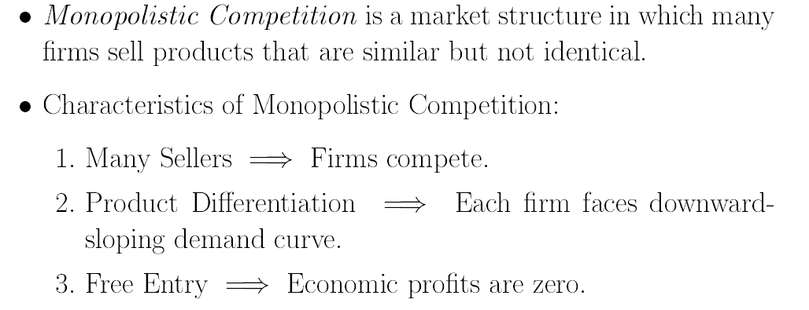

Slide 27
Monopolistic Competition
Characteristics
Many firms
Free entry and exit
Differentiated product
Notes:
4

Slide 28
Monopolistic Competition
The amount of monopoly power depends on the degree of differentiation
Examples of this very common market structure include:
Toothpaste
Soap
Cold remedies
Notes:
5

Slide 29
Monopolistic Competition
Two important characteristics
Differentiated but highly substitutable products
Free entry and exit
Notes:
7

Slide 30
A Monopolistically Competitive Firm in the Short and Long Run
$/Q
Short Run
$/Q
Long Run
MC
MC
AC
AC
P_{SR}
P_{LR}
D_{SR}
D_{LR}
MR_{SR}
MR_{LR}
Q_{SR}
Quantity
Q_{LR}
Quantity
Notes:
12

Slide 31
A Monopolistically Competitive Firm in the Short and Long Run
Short run
Downward sloping demand – differentiated product
Demand is relatively elastic – good substitutes
MR < P
Profits are maximized when MR = MC
This firm is making economic profits
Notes:
13

Slide 32
A Monopolistically Competitive Firm in the Short and Long Run
Long run
Profits will attract new firms to the industry (no barriers to entry)
The old firm’s demand will decrease to DLR
Firm’s output and price will fall
Industry output will rise
No economic profit (P = AC)
P > MC → some monopoly power
Notes:
14

Slide 33
Practice set-1 (T2)
Q1. Let demand and cost functions be given as:
P=100-0.5(q₁+q₂)
C₁=5q₁
C₂=0.5q₂²
Find the reaction functions and Cournot equilibrium solution.
(P=? q₁=? q₂=? ∏₁=? ∏₂=?)

Slide 34
Q2. Suppose that the two firms face a linear demand curve P(y)= a-by and have constant marginal costs, c, for each firm.
Solve for Cournot equilibrium output.
y = total output= y₁ + y₂

Slide 35
Thanking BITS PILANI, K.K.BIRLA GOA CAMPUS
Under the aegis of
Department of Economics
Dr. Mridula Goel (HOD)
Dr. Debashish Pattanaik
Dr. Aswini Kumar Mishra
Dr. Kubendran N.
Dr. Indranil De
Ms. Ambili K.
Mr. Swagat Kishore Mishra

